Slide 1
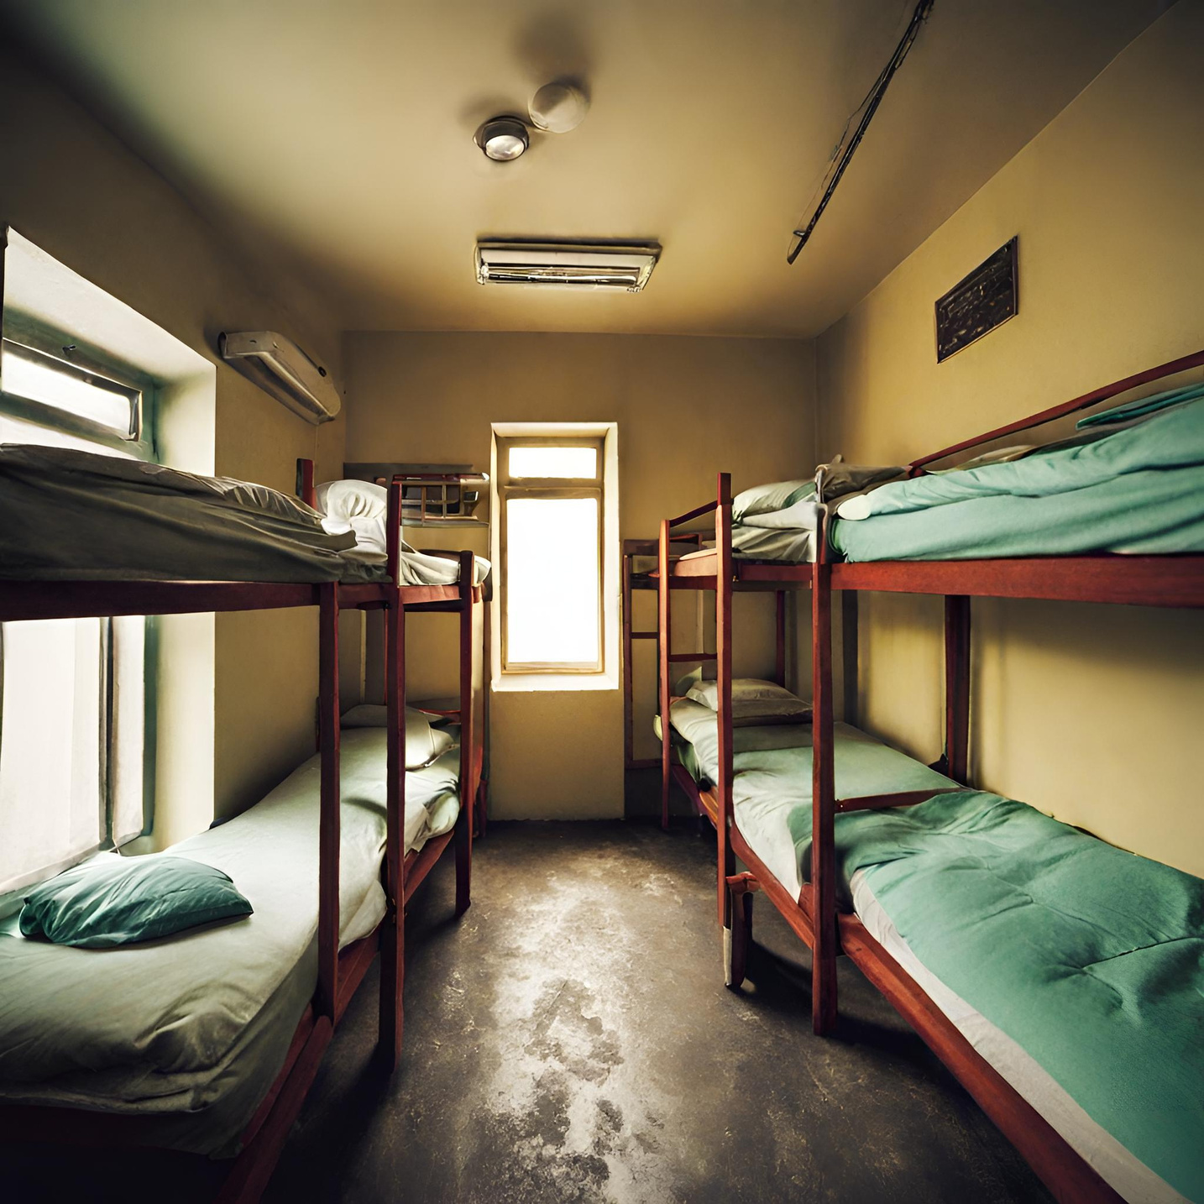




SWIFTROOM
ALLOCATOR

Slide 2




GOALS AND OBJECTIVES
01
Allowing the customers to be able to book a room in simple steps and according to their preference.
02
Allowing the admin to monitor the rooms and students in the hostel and their data with ease.
03
Making the process of booking, changing or leaving the room smooth and streamline the process for everyone invloved.

Slide 3
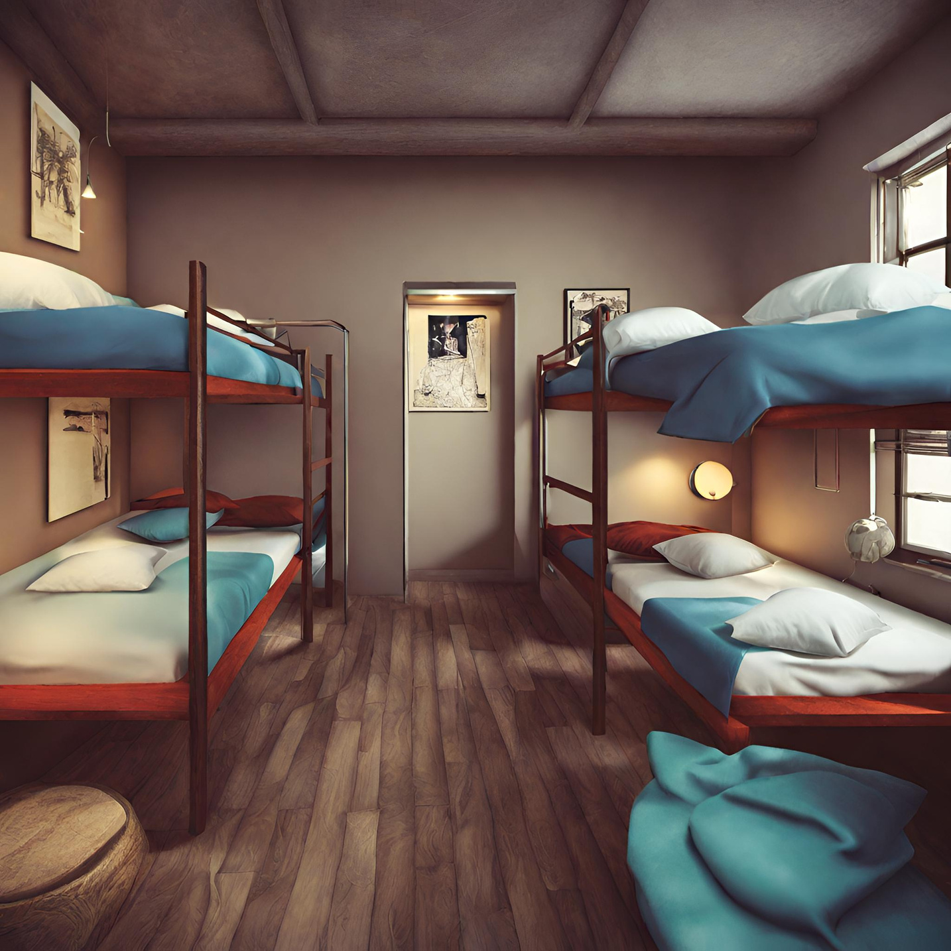


CONCEPT
Swift Room Allocator is a room allotment system which enables a customer to easily choose their room.
It gives the customer features to ease the process and allow them to get desired room.

Slide 4
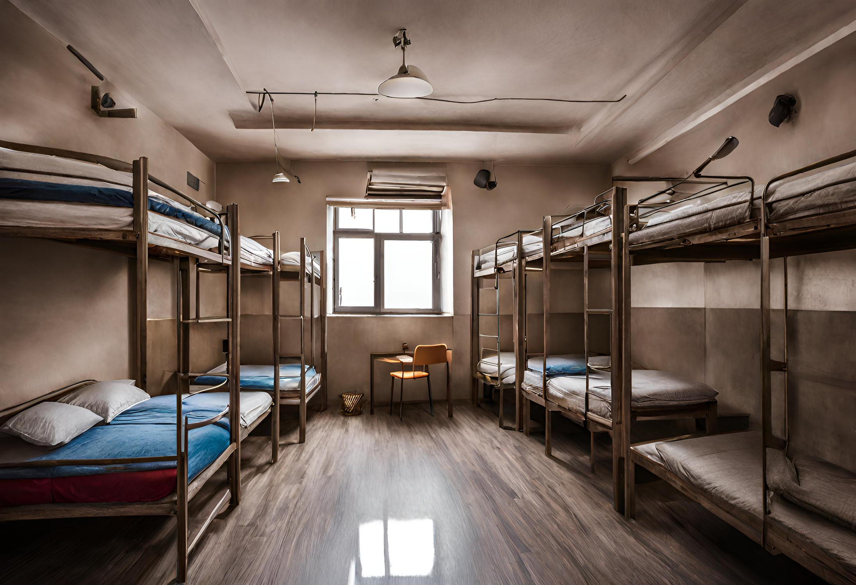



FUNCTIONALITIES
Searching Room using different filters to get desired rooms
Multiple Actions for both User and Admin
Fast and Easy to use

Slide 5
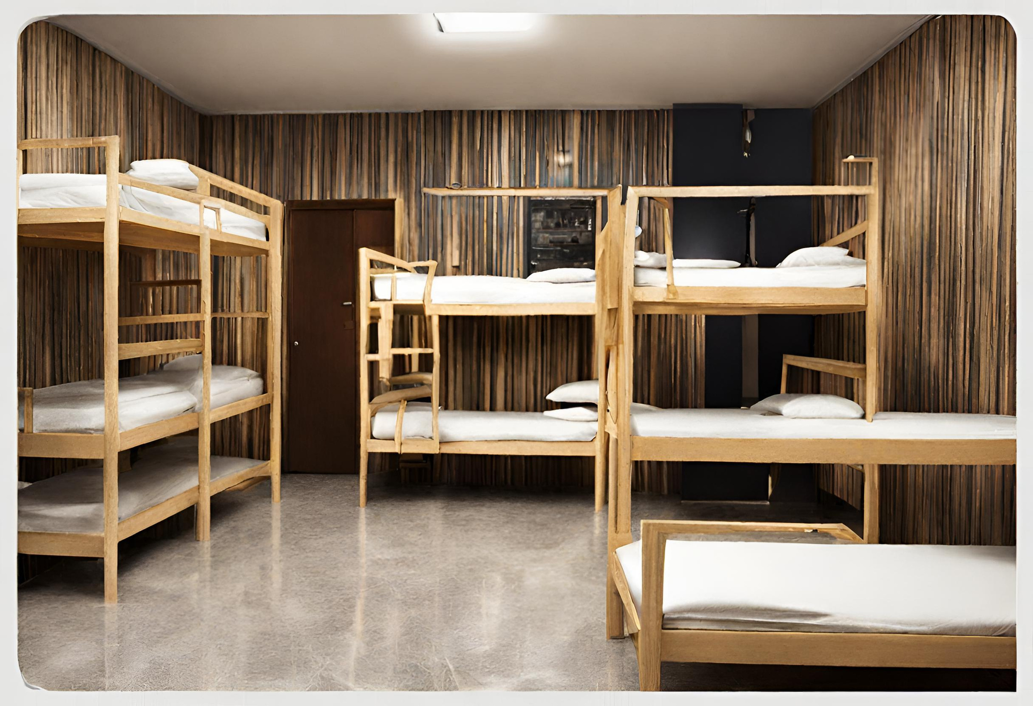




FEATURES
Book Room
Change Room
Leave Room
Admin Login
Book your desired room according to your personal preference.
Change your room if facing any problem without any inconvenience
Leave booked room without going through lots and lots of paperwork.
Admin can view all the info about both rooms and students.

Slide 6
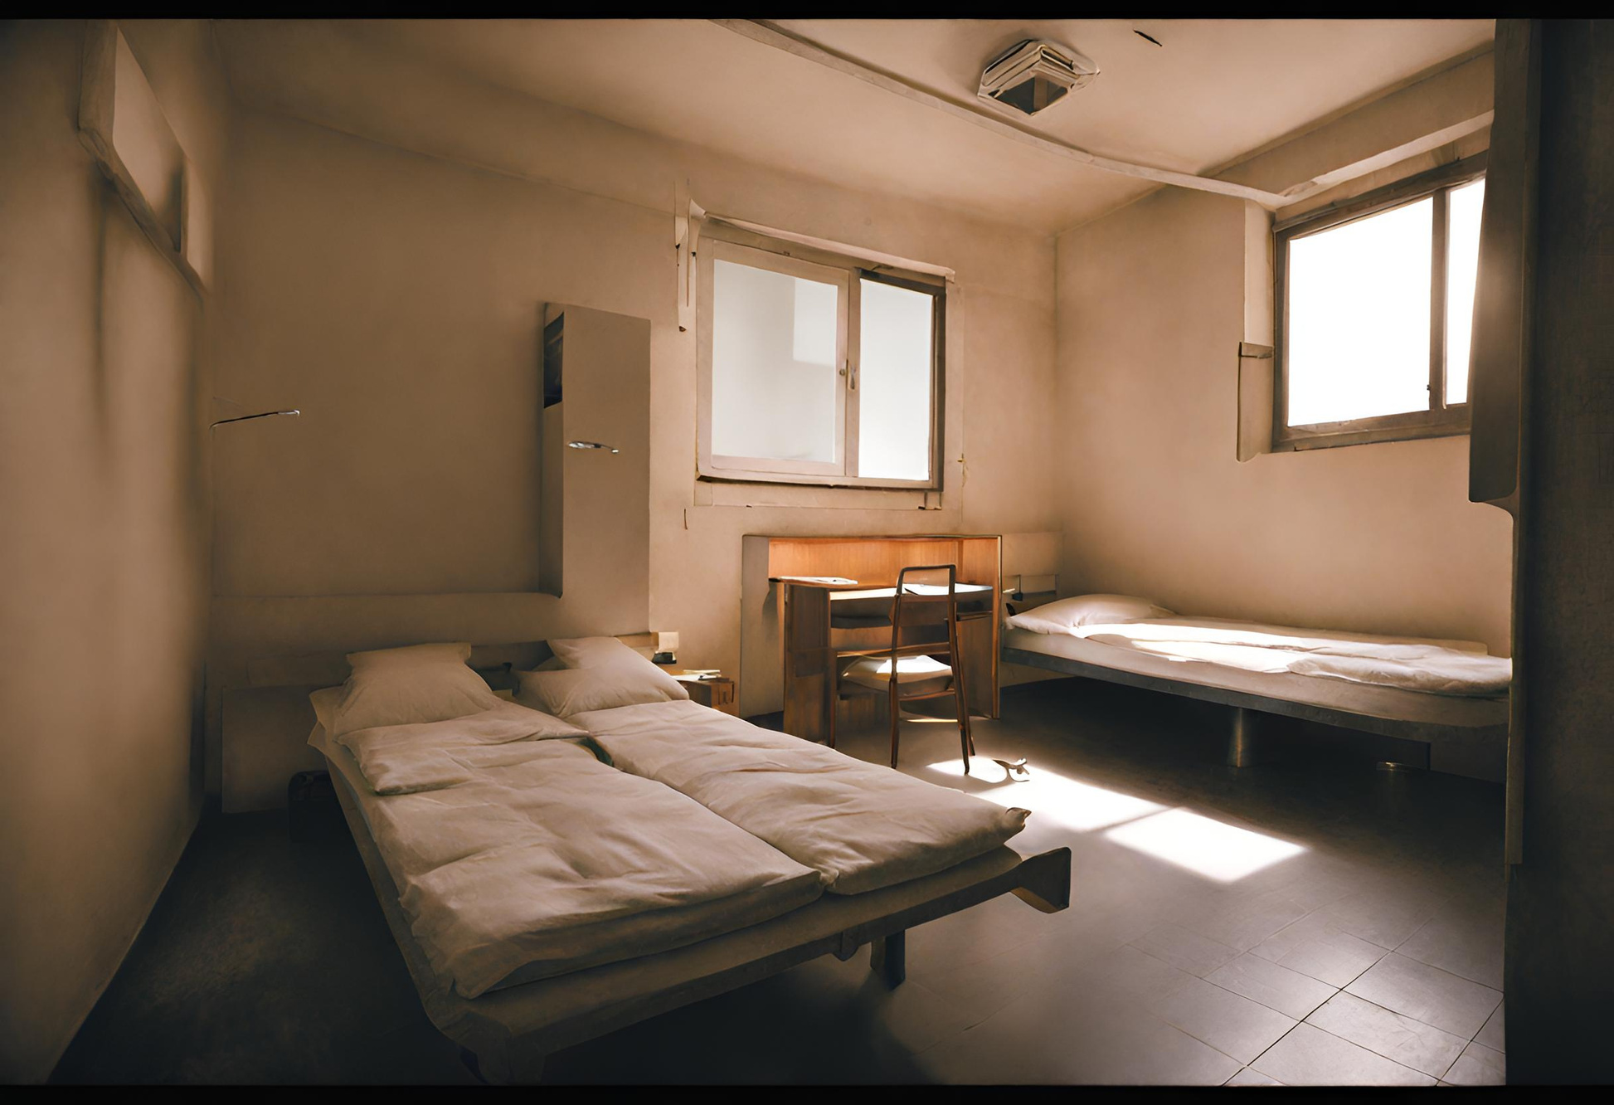
OUR TEAM
Madhav Goyal
Pranav Saluja
Umesh

Slide 7
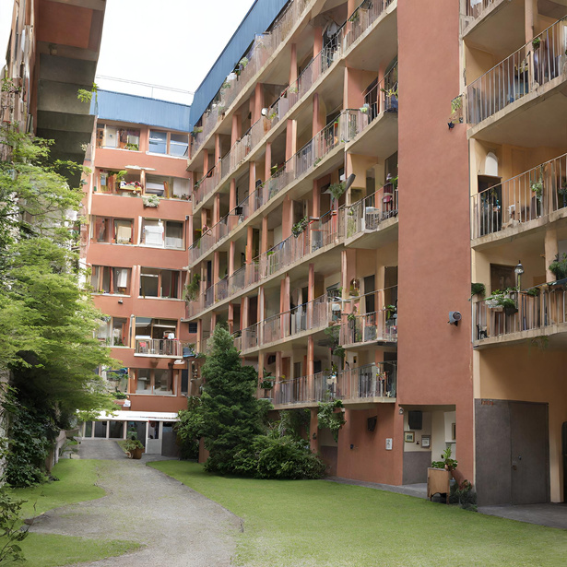
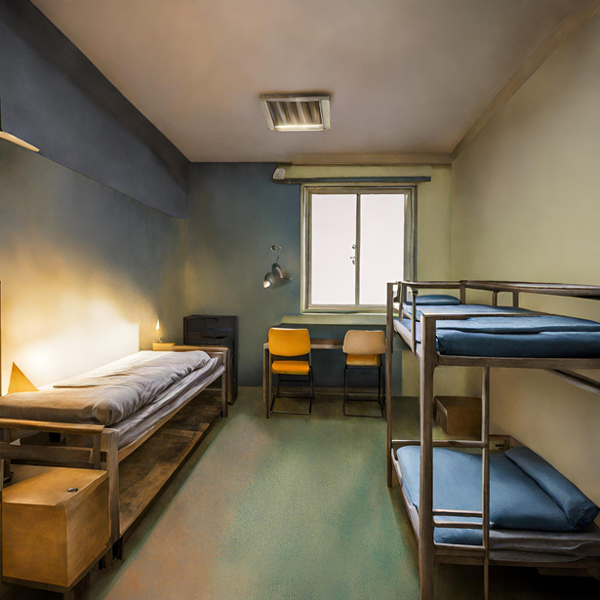


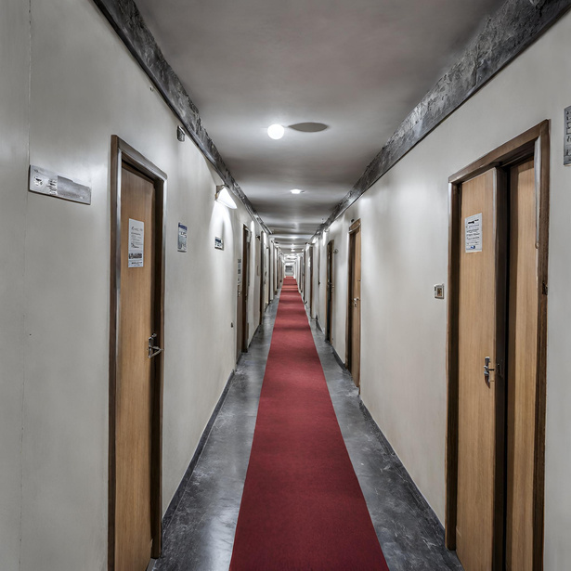
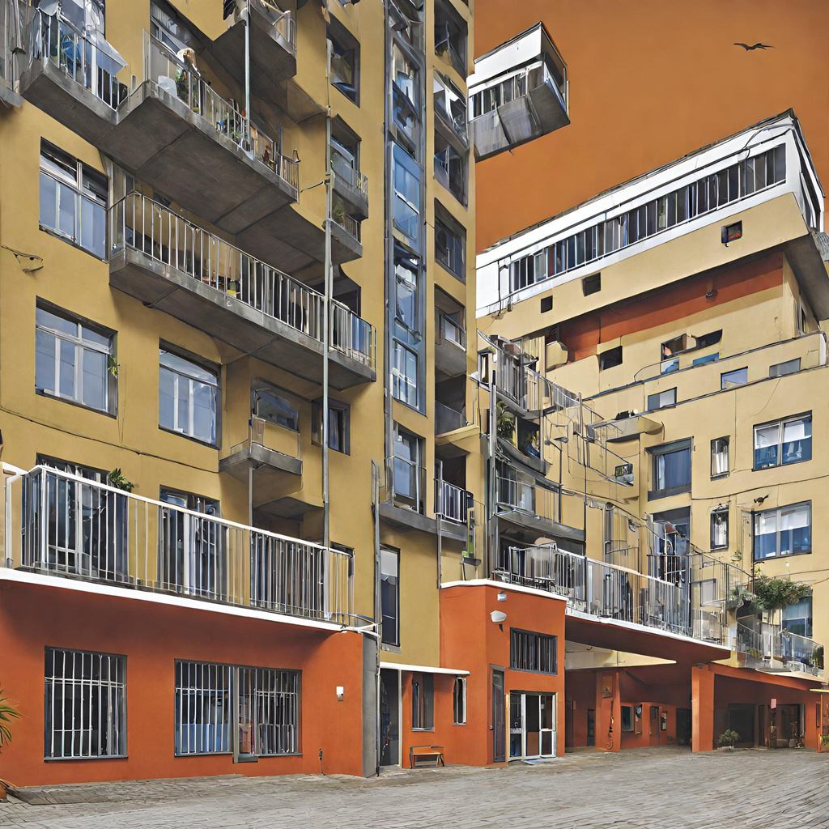

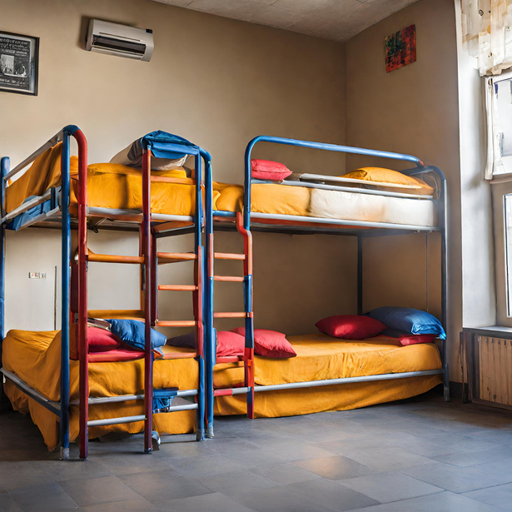
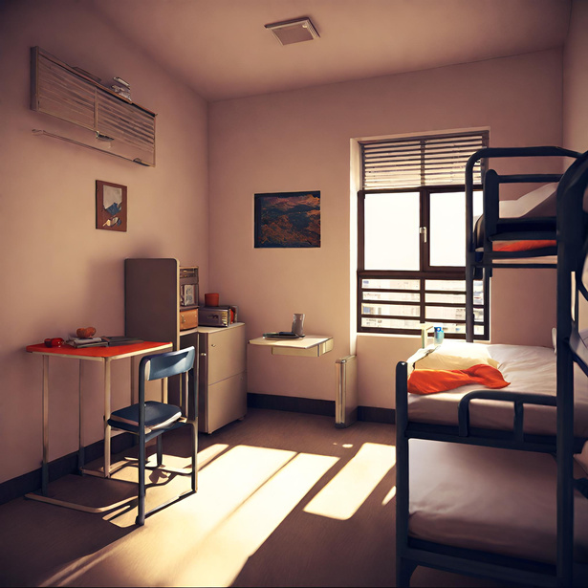

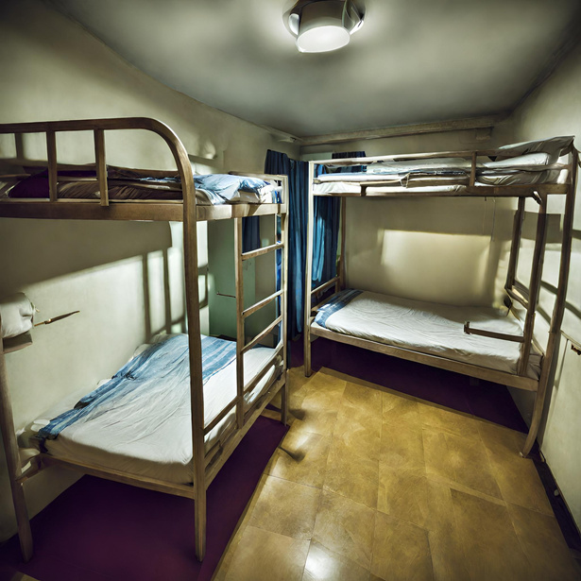
SWIFTROOM
THANK'S FOR WATCHING

